Slide 1
SQL Constraints

Slide 2
Constraints can be specified when the table is created with the CREATE TABLE statement, or after the table is created with the ALTER TABLE statement.
SQL constraints are used to specify rules for the data in a table.
Constraints are used to limit the type of data that can go into a table. This ensures the accuracy and reliability of the data in the table.

Slide 3
CREATE TABLE table_name (
column1 datatype constraint,
column2 datatype constraint,
column3 datatype constraint,
....
);

Slide 4
NOT NULL - Ensures that a column cannot have a NULL value
UNIQUE - Ensures that all values in a column are different
PRIMARY KEY - A combination of a NOT NULL and UNIQUE. Uniquely identifies each row in a table
FOREIGN KEY - Uniquely identifies a row/record in another table
CHECK - Ensures that all values in a column satisfies a specific condition
DEFAULT - Provides a default value for a column

Slide 5
NOT NULL
By default, a column can hold NULL values.
The NOT NULL constraint enforces a column to NOT accept NULL values.

Slide 6
Example:-
CREATE TABLE Employees09(
Emp_ID int NOT NULL,
LastName varchar(255) NOT NULL,
FirstName varchar(255) NOT NULL,
Deparment varchar(255) NOT NULL, Acct_No varchar(255) NOT NULL
);

Slide 7
UNIQUE Constraint
The UNIQUE constraint ensures that all values in a column are different.
Both the UNIQUE and PRIMARY KEY constraints provide a guarantee for uniqueness for a column or set of columns.
A PRIMARY KEY constraint automatically has a UNIQUE constraint.
However, you can have many UNIQUE constraints per table, but only one PRIMARY KEY constraint per table.

Slide 8
EXAMPLE
CREATE TABLE Person20 (
ID int NOT NULL UNIQUE, LastName varchar(255) NOT NULL,
FirstName varchar(255),
Age int
);

Slide 9
Multiple Columns
CREATE TABLE Persons (
ID int NOT NULL,
LastName varchar(255) NOT NULL,
FirstName varchar(255),
Age int, CONSTRAINT UC_Person UNIQUE (ID)
);
With Alter Command
ALTER TABLE Persons
ADD UNIQUE (ID);
Drop Unique Constraint
ALTER TABLE Persons
DROP CONSTRAINT UC_Person;

Slide 10
PRIMARY KEY Constraint
The PRIMARY KEY constraint uniquely identifies each record in a database table.
Primary keys must contain UNIQUE values, and cannot contain NULL values.
A table can have only one primary key, which may consist of single or multiple fields.

Slide 11
CREATE TABLE Persons (
ID int PRIMARY KEY,
LastName varchar(255) NOT NULL,
FirstName varchar(255),
Age int
);
On Alter Table
ALTER TABLE Persons
ADD PRIMARY KEY (ID);
Drop Primary Key
ALTER TABLE Persons
DROP PRIMARY KEY;

Slide 12
FOREIGN KEY Constraint
A FOREIGN KEY is a key used to link two tables together typically using a column in one table that matches the primary key of second table.
A FOREIGN KEY is a field (or collection of fields) in one table that refers to the PRIMARY KEY in another table.
The table containing the foreign key is called the child table, and the table containing the candidate key is called the referenced or parent table.

Slide 13
In a relational database, a foreign key is used to establish a relationship with another table in the same database.
It is a mechanism that ensures referential integrity between two related tables.
This allows data to be retrieved from multiple tables by using joins.

Slide 14
For example: we have two tables: Orders and Customers .
The order table may have foreign key column called customer_id column. This relationship allows you to retrieve information about the customer associated with each order.

Slide 15
Foreign key helps to ensure data consistency and integrity by preventing invalid data from being inserted in to database.
If a foreign key constraint is defined on a table, the database engine will not allow an insert or update to that table that violates the constraint.

Slide 16
PersonID | LastName | FirstName | Age
1 | Hansen | Ola | 30
2 | Svendson | Tove | 23
3 | Pettersen | Kari | 20
OrderID | OrderNumber | PersonID
1 | 77895 | 3
2 | 44678 | 3
3 | 22456 | 2
4 | 24562 | 1

Slide 17
CREATE TABLE Orders (
OrderID int NOT NULL,
OrderNumber int NOT NULL,
PersonID int,
PRIMARY KEY (OrderID),
FOREIGN KEY (PersonID) REFERENCES Persons(PersonID)
);

Slide 18
CHECK Constraint
The CHECK constraint is used to limit the value range that can be placed in a column.
If you define a CHECK constraint on a single column it allows only certain values for this column.
If you define a CHECK constraint on a table it can limit the values in certain columns based on values in other columns in the row.

Slide 19
CREATE TABLE Persons (
ID int NOT NULL,
LastName varchar(255) NOT NULL,
FirstName varchar(255),
Age int CHECK (Age>=18)
);
CREATE TABLE Persons (
ID int NOT NULL,
LastName varchar(255) NOT NULL,
FirstName varchar(255),
Age int,
City varchar(255),
CONSTRAINT CHK_Person CHECK (Age>=18 AND City='Sandnes')
);

Slide 20
With Alter
ALTER TABLE Persons
ADD CONSTRAINT CHK_PersonAge CHECK (Age>=18 AND City='Sandnes');
Drop
ALTER TABLE Persons
DROP CONSTRAINT CHK_PersonAge;

Slide 21
DEFAULT Constraint
The DEFAULT constraint is used to provide a default value for a column.
The default value will be added to all new records IF no other value is specified.
Example: CREATE TABLE Persons (
ID int NOT NULL,
LastName varchar(255) NOT NULL,
FirstName varchar(255),
Age int,
City varchar(255) DEFAULT 'Sandnes'
);

Slide 22
With Alter
ALTER TABLE Persons
MODIFY City DEFAULT 'Sandnes';

Slide 23
Example For Primary Key:
create table agent1(id int primary key, name varchar(255), address varchar(255), age int, salary int);

Slide 24
Examples:
Example For Not Null:
create table record(name varchar(255) not null, branch varchar(255) not null, address varchar(255));
insert into record(name, branch, address)values(‘Ram','cse',' ');

Slide 25
Example For Default:
create table mytab2(name varchar(255),age int default 18, address varchar(255));
insert into mytab2(name,address)values('ram','delhi');

Slide 26
Example For Foreign Key
create table person3(personid int primary key, lastname varchar(255), firstname varchar(255), age int);
insert into person3(personid, lastname, firstname ,age)values(3,'Petterson','Kari',20);
select * from person3;

Slide 27
To create Referencing table(child table)
create table orders(orderid int not null, ordernumber int not null, personid int, primary key(orderid), foreign key(personid) REFERENCES person3(personid));

Slide 28

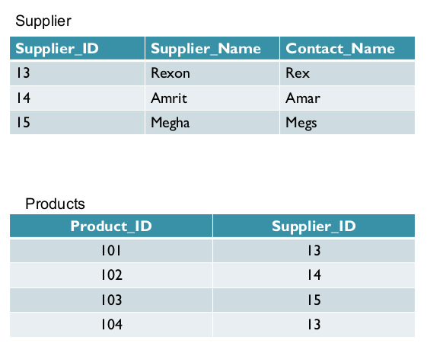
Practice table for Foreign Key

Slide 29
Example For Check Constraint
create table studentinfo(name varchar(255), rollno int, age int check(age>=18));

Slide 30
To drop a Primary Key in a table
alter table employee drop Primary Key;
To create a primary key constraint when table is already created
Alter table Persons add primary key ();

